Slide 1
Smartbots
A Differentiated Learning Platform

Slide 2
Smartbots – the need
The group level identification of learning requirements and setting the objectives suffers from inherent drawbacks of levelling the players and not the field.
Nature does not create anything equal, but manages inequality beautifully.
Each Human brain has the capacity to adopt, learn and acquire knowledge and skills at varying levels.
This requires that we need to create a level field by providing differentiated learning platform (DLP)
The DLP concept inherently assumes that each learner has a different requirements and hence should be provided with different levels of and types of content. Uniqueness is the Key not uniformity.

Slide 3
Smartbots Modules
PLET
Student Entry
Pre Learning Evaluation Technique
EGL
Grade Matrix
Evaluation Graded Learner
SCD
Content Mapper
Smart Content Distributor
Smart Watch
Student Exit

Slide 4

Pre-Learning Evaluation Technique (PLET)
Smartbots begins with an understanding that the learning is not uniform but unique
Smartbots is a way of offering the content to the individuals based on their level of understanding.
Every learner will undergo a self evaluation using the PLET- Pre-learning Evaluation Techniques module.
By conducting this test we can identify the depth of knowledge that a student has acquired on that particular domain.
Our Smartbots can offer both customizable and canned test based on the requirement.
Based on the output of the PLET, a learner is graded.

Slide 5
Grading Matrix and Content Mapper
The Grading Matrix is pre-determined for each learning object and depends on the objectives of learning.
The GM is customizable and can be different for each learning object.
The learner grading will be used to provide him the right level and type of content using Smart Content Distributor (SCD)
Content mapper is the learning object-oriented distribution matrix of each content which will be mapped to grading matrix.

Slide 6
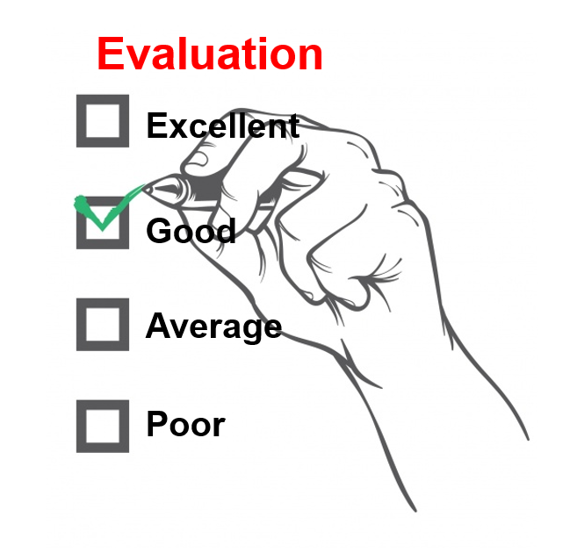
Evaluation Graded Learner (EGL)
The EGL Module will store the PLET grades for each student for each learning object.
EGL has the capability to provide the grading matrix.
Based on the Grade pursued by the student, the relevant course content is mapped.
Once the learner obtains the skill, there will be a continuous evaluation by way of assignments, or tasks as per the learning program.
The results will be stored within EGL and the revised grading is done.

Slide 7
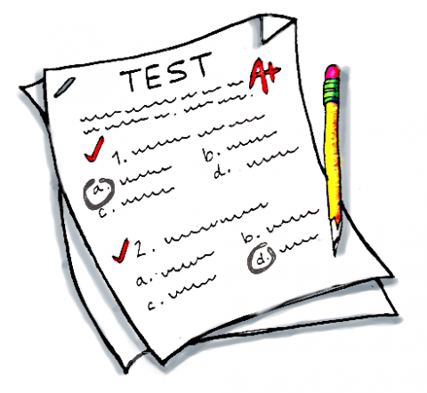
Smart Content Distributor (SCD)
The Smart content distributor contains a pre-determined Grade-Content mapping for each learning object.
Based on the Student Grading Matrix (SGM), the content is mapped to the students.
Depending on the level of acceptance by the student, the higher level of content is offered.
The Content distributor will offer the content grid. The course is mapped to the particular student depending on their grading.

Slide 8

Smart Watch
The Smart Watch module will then use the growth mapping based on grade movements and matches the same to the desired grade for the learning object.
The smart watch also measures the effort on learning in terms of the time spent for learning.
Based on the combination of both factors, the Smart Watch will provide the SCD inputs for content distribution and to the EGL for evaluation management.
This iterative process ensures that every student will get a differentiated learning experience that best suits for the student and thus ensures that every student benefits by engaging him at the level of his capability.
Review Matrix has the following parameters:
Redo
Learn more
Move next
High improvement
The result is sent to both student and mentor.

Slide 9
Smartbots – a Differentiated Learning Platform
Smartbots begins with an understanding that the learning is not uniform but unique
Every learner will undergo a self evaluation using the PLET- Pre-learning Evaluation Techniques module.
Based on the output of the PLET, a learner is graded.
The Grade Matrix is pre-determined for each learning object and depends on the goals or objectives of learning.
The learner grading will be used to provide him the right level and type of content using Smart Content Distributor (SCD)
The Smart content distributor contains a pre-determined Grade-Content mapping for each learning object.
The EGL Module will store the PLET grades for each student for each learning object. Once the learner obtains the skill, there will be a continuous evaluation by way of assignments, tests or tasks as per the learning program the result of which will be also stored within EGL and the revised grading is done.
The Smart Watch module will then use the growth mapping based on grade movements and matches the same to the desired grade for the learning object. The smart watch also measures the effort on learning in terms of the time spent for learning. Based on the combination of both factors, the Smart Watch will provide the SCD inputs for content distribution and to the EGL for evaluation management.
This iterative process ensures that every student will get a differentiated learning experience that best suits for the student and thus ensures that every student benefits by engaging him at the level of his capability.

